Slide 1
Chapter 5: Process Synchronization

Slide 2
Chapter 5: Process Synchronization
Background
The Critical-Section Problem
Peterson’s Solution
Synchronization Hardware
Mutex Locks
Semaphores
Classic Problems of Synchronization
Monitors
Synchronization Examples
Alternative Approaches

Slide 3
Objectives
To present the concept of process synchronization.
To introduce the critical-section problem, whose solutions can be used to ensure the consistency of shared data
To present both software and hardware solutions of the critical-section problem
To examine several classical process-synchronization problems
To explore several tools that are used to solve process synchronization problems

Slide 4
Background
A cooperating process is one that can affect or be affected by other processes executing in the system.
Cooperating processes can directly share a logical address space (both code and data).
Concurrent access to shared data may result in data inconsistency
Various mechanisms are available to ensure the orderly execution of cooperating processes that share a logical address space, so that data consistency is maintained.

Slide 5
Bounded-Buffer – Shared-Memory Solution
Shared data
#define BUFFER_SIZE 10
typedef struct {
. . .
} item;
item buffer[BUFFER_SIZE];
int in = 0;
int out = 0;
Solution is correct, but can only use BUFFER_SIZE-1 elements

Slide 6
Bounded-Buffer – Producer
item next_produced;
while (true) {
/* produce an item in next produced */
while (((in + 1) % BUFFER_SIZE) == out)
; /* do nothing */
buffer[in] = next_produced;
in = (in + 1) % BUFFER_SIZE;
}

Slide 7
Bounded Buffer – Consumer
item next_consumed;
while (true) { while (in == out)
; /* do nothing */ next_consumed = buffer[out];
out = (out + 1) % BUFFER_SIZE;
/* consume the item in next consumed */
}

Slide 8
Alternate Solution
Suppose that we wanted to provide a solution to the consumer-producer problem that removes the restriction of having at most BUFFER_SIZE-1 items.
We can do so by having an integer counter that keeps track of the number of full buffers.
Initially, counter is set to 0.
It is incremented by the producer after it produces a new buffer and is decremented by the consumer after it consumes a buffer.

Slide 9
Producer
while (true) { /* produce an item in next produced */
while (counter == BUFFER_SIZE) ;
/* do nothing */
buffer[in] = next_produced;
in = (in + 1) % BUFFER_SIZE;
counter++;
}

Slide 10

Consumer
while (true) {
while (counter == 0)
; /* do nothing */
next_consumed = buffer[out];
out = (out + 1) % BUFFER_SIZE;
counter--;
/* consume the item in next consumed */
}

Slide 11
What Can Go Wrong?
counter++ could be implemented as register1 = counter register1 = register1 + 1 counter = register1
counter-- could be implemented as register2 = counter register2 = register2 - 1 counter = register2
Consider this execution interleaving with “counter = 5” initially:
S0: producer executes register1 = counter {register1 = 5}
S1: producer executes register1 = register1 + 1 {register1 = 6}
S2: consumer executes register2 = counter {register2 = 5}
S3: consumer executes register2 = register2 – 1 {register2 = 4}
S4: producer executes counter = register1 {counter = 6}
S5: consumer executes counter = register2 {counter = 4}

Slide 12
What Can Go Wrong?
If we reverse S4 and S5 get Counter=6
Consider this execution interleaving with “count = 5” initially:
S0: producer execute register1 = counter {register1 = 5}
S1: producer execute register1 = register1 + 1 {register1 = 6}
S2: consumer execute register2 = counter {register2 = 5}
S3: consumer execute register2 = register2 – 1 {register2 = 4}
S4: consumer execute counter = register2 {counter = 4}
S5: producer execute counter = register1 {counter = 6}

Slide 13
What Can Go Wrong?
If we reverse S4 and S5 get Counter=6
Consider this execution interleaving with “counter = 5” initially:
S0: producer executes register1 = counter {register1 = 5}
S1: producer executes register1 = register1 + 1 {register1 = 6}
S2: consumer executes register2 = counter {register2 = 5}
S3: consumer executes register2 = register2 – 1 {register2 = 4}
S4: consumer executes counter = register2 {counter = 4}
S5: producer executes counter = register1 {counter = 6}

Slide 14

Race Condition
A situation where several processes access and manipulate the same data concurrently and the outcome of the execution depends on the particular order in which the access takes place.
We need a way to synchronize the processes so that only one process at a time can be manipulating a critical data item.

Slide 15
Critical Section Problem
Consider system of n processes {p₀, p₁, … p_{n-1}}
Each process has critical section segment of code
Process may be changing common variables, updating table, writing file, etc
When one process in critical section, no other may be in its critical section
Critical section problem is to design a protocol to support this
Each process
must ask permission to enter critical section in entry section
may follow critical section with exit section
The remaining code is the remainder section

Slide 16
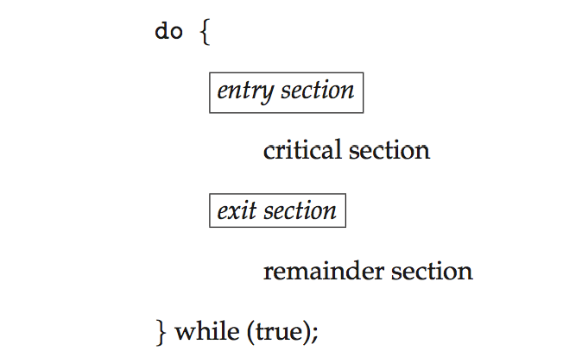
Critical Section Process Structure
General structure of process P_{i}

Slide 17

Solution to Critical-Section Problem
1. Mutual Exclusion - If process P_{i} is executing in its critical section, then no other processes can be executing in their critical sections
Progress - If no process is executing in its critical section and some processes wish to enter their critical sections,
only those processes that are not executing in their remainder sections can participate in deciding which will enter its critical section next, and
this selection cannot be postponed indefinitely
3. Bounded Waiting - A bound must exist on the number of times that other processes are allowed to enter their critical sections after a process has made a request to enter its critical section and before that request is granted
Assume that each process executes at a nonzero speed
No assumption concerning relative speed of the n processes

Slide 18

Areas Prone to Race Conditions
Kernel Open Files data structure
List must be modified when a new file is opened or closed
If two processes were to open files simultaneously, the separate updates to this file could cause a race condition
Memory Allocation Structures
Process List Structures
Interrupt Handling

Slide 19
Algorithm for Process P_{i}
do {
while (turn == j);
critical section
turn = j;
remainder section
} while (true);

Slide 20
Critical-Section Handling in OSs
Non-preemptive – runs until exits kernel mode, blocks, or voluntarily yields CPU
Essentially free of race conditions in kernel mode
Preemptive – allows preemption of process when running in kernel mode
Are hard to design especially in SMP (Symmetric Multiprocessors) architectures where two kernel-mode processes can be running simultaneously on different processors.
Why choose preemptive?
More responsive since risk of long-running processes holding up the works is eliminated
More suitable for real-time programming as real-time processes can preempt as needed.

Slide 21
Peterson’s Solution
Good algorithmic description of solving the problem
Two process solution
Assume that the load and store machine-language instructions are atomic; that is, cannot be interrupted
The two processes share two variables:
int turn;
Boolean flag[2]
The variable turn indicates whose turn it is to enter the critical section
The flag array is used to indicate if a process is ready to enter the critical section. flag[i] = true implies that process P_{i} is ready!

Slide 22
Algorithm for Process P_{i}
do {
flag[i] = true;
turn = j;
while (flag[j] && turn = = j);
critical section
flag[i] = false;
remainder section
} while (true);

Slide 23
Peterson’s Solution (Cont.)
Provable that the three CS requirement are met:
1. Mutual exclusion is preserved
P_{i} enters CS only if:
either flag[j] = false or turn = i
2. Progress requirement is satisfied
3. Bounded-waiting requirement is met

Slide 24
Synchronization Hardware
Many systems provide hardware support for implementing the critical section code.
All solutions below based on idea of locking
Protecting critical regions via locks
Uniprocessors – could disable interrupts
Currently running code would execute without preemption
This is the approach generally taken for non-preemptive kernels
Generally too inefficient on multiprocessor systems.
Why?
Message is passed to all processors
This delays entry into each critical section decreasing system efficiency
May impact clock performance if clock is updated using interrupts

Slide 25

Synchronization Hardware
Modern machines provide special atomic hardware instructions
Atomic = non-interruptible
test and modify contents of memory word
swap contents of two memory words
These instructions can be used to solve the critical section problem.

Slide 26
test_and_set Instruction
Definition:
boolean test_and_set (boolean *target)
{
boolean rv = *target;
*target = TRUE;
return rv:
}
Executed atomically
Returns the original value of passed parameter
Set the new value of passed parameter to “TRUE”.

Slide 27
Solution using test_and_set()
Shared Boolean variable lock, initialized to FALSE
Solution:
do { while (test_and_set(&lock))
; /* do nothing */
/* critical section */
lock = false;
/* remainder section */
} while (true);

Slide 28
compare_and_swap Instruction
Definition:
int compare _and_swap(int *value, int expected, int new_value) {
int temp = *value;
if (*value == expected)
*value = new_value;
return temp;
}
Executed atomically
Returns the original value of passed parameter “value”
Set the variable “value” the value of the passed parameter “new_value” but only if “value” ==“expected”. That is, the swap takes place only under this condition.

Slide 29
Solution using compare_and_swap
Shared integer “lock” initialized to 0;
Solution:
do { while (compare_and_swap(&lock, 0, 1) != 0)
; /* do nothing */
/* critical section */
lock = 0;
/* remainder section */
} while (true);

Slide 30
Bounded-waiting Mutual Exclusion with test_and_set
do { waiting[i] = true; key = true; while (waiting[i] && key)
key = test_and_set(&lock);
waiting[i] = false;
/* critical section */
j = (i + 1) % n;
while ((j != i) && !waiting[j])
j = (j + 1) % n;
if (j == i)
lock = false;
else
waiting[j] = false;
/* remainder section */
} while (true);

Slide 31
Mutex Locks
OS designers build software tools to solve critical section problem
Simplest is mutex lock: (mutual exclusion)
Protect a critical section by first acquire() a lock then release() the lock
Boolean variable available indicating if lock is available or not
Usually implemented via hardware atomic instructions
do {
acquire lock
critical section
release lock
remainder section
} while (TRUE);

Slide 32
acquire() and release()
acquire() { while (!available)
; /* busy wait */
available = false;;
}
release() {
available = true;
}
do {
acquire lock
critical section
release lock
remainder section
} while (true);

Slide 33

Mutex Locks
But this solution requires busy waiting
When a process is in its critical section, any other process that tries to enter its critical section must loop continuously in the calls to acquire()
and is therefore called a spinlock because the process spins while waiting for the lock to become available.
In a single CPU multiprogramming environment busy waiting wastes CPU cycles that could be used by other processes.
But…
Spinlocks do not require context switching and are efficient when locks are expected to be held for short times.
Multiprocessor systems are good candidates for spinlocks as another thread can enter its critical section on another processor.

Slide 34
Solution to Critical-section Problem Using Locks
do {
acquire lock
critical section
release lock
remainder section
} while (TRUE);

Slide 35
Semaphore
Synchronization tool that provides more sophisticated ways (than Mutex locks) for processes to synchronize their activities.
Semaphore S – integer variable
Can only be accessed via two indivisible (atomic) operations
wait() and signal()
Definition of the wait() operation
wait(S) {
while (S <= 0)
; // busy wait
S--;
}
Definition of the signal() operation
signal(S) {
S++;
}

Slide 36
Semaphore Usage
Counting semaphore – integer value can range over an unrestricted domain
Used to provide access to a resource consisting of a finite # of resources
The semaphore is initialized to the number of available resources
Each process that wishes to use a resource performs a wait() operation the decrements the semaphore
When a process releases a resource, it performs a signal() operations that increments the semaphore.
When the semaphore goes to 0, all resources are being used.
After that, all processes that wish to use a resource will block until the count becomes >0.

Slide 37
Semaphore Usage
Binary semaphore – integer value can range only between 0 and 1
Same as a mutex lock (and they suffer from busy-wait too)
Can solve various synchronization problems
Consider P₁ and P₂ that require S₁ to happen before S₂
Create a semaphore synch initialized to 0
P₁ :
S₁;
signal(synch);
P₂ :
wait(synch);
S₂;
Because synch is set to 0, P₂ will execute S₂ only after P₁ has invoked signal (synch) which is after statement S₁ has been executed.

Slide 38
Semaphore Implementation
We can modify the definition of wait() and signal() as follows:
When a process executes a wait() operation and finds that the semaphore value is not positive, it must wait.
Rather than engaging in busy waiting, the process can block itself.
The block operations puts the process into a waiting queue associated with the semaphore and the state of the process is switched to ‘waiting’.
Control is transferred to the CPU scheduler which selects another process to execute.
A process that is blocked should be restarted using the wakeup() operation when some other process executes a signal() operation.
This changes the process state to ‘ready’ and it will get scheduled based on the CPU scheduler’s priority algorithm

Slide 39
Semaphore Implementation with no Busy waiting
With each semaphore there is an associated waiting queue
Each entry in a waiting queue has two data items:
value (of type integer)
pointer to next record in the list
Two operations:
block – place the process invoking the operation on the appropriate waiting queue
wakeup – remove one of processes in the waiting queue and place it in the ready queue
typedef struct{
int value;
struct process *list;
} semaphore;

Slide 40
Implementation with no Busy Waiting (Cont.)
wait(semaphore *S) {
S->value--;
if (S->value < 0) { add this process to S->list;
block();
}
}
signal(semaphore *S) {
S->value++;
if (S->value <= 0) { remove a process P from S->list;
wakeup(P);
}
}
Semaphore values can be negative.
Magnitude = # of processes waiting

Slide 41

Semaphore Implementation
Must guarantee that no two processes can execute the wait() and signal()on the same semaphore at the same time

Slide 42
Implementation with no Busy waiting (Cont.)
wait and signal must be implemented atomically.
This is a critical section problem which can be solved in a single-processor environment by disabling interrupts while these are executing.
Once interrupts are inhibited, instructions from different processes cannot be interleaved.
In a multi-processor environment, interrupts must be disabled on every processor or else instructions from different processes running on different processors may be interleaved arbitrarily.
This diminishes performance on SMP (symmetric multiprocessing) systems.

Slide 43
Implementation with no Busy waiting (Cont.)
Thus, the implementation becomes the critical section problem where the wait and signal code are placed in the critical section
Could now have busy waiting in critical section implementation
But implementation of wait and signal code is short
Little busy waiting if critical section rarely occupied
Busy waiting is more of a concern in applications that may spend a long time in their critical section and therefore this is not a good solution

Slide 44
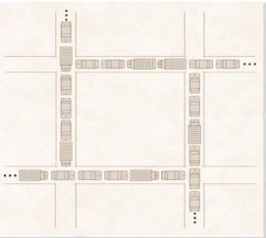
Deadlock

Slide 45
Deadlock and Starvation
Deadlock – two or more processes are waiting indefinitely for an event that can be caused by only one of the waiting processes
Let S and Q be two semaphores initialized to 1
P₀ P₁
wait(S); wait(Q);
wait(Q); wait(S);
... ...
signal(S); signal(Q);
signal(Q); signal(S);
Starvation – indefinite blocking
A process may never be removed from the semaphore queue in which it is
BLOCKED
BLOCKED

Slide 46
Deadlock and Starvation
Four necessary conditions for deadlock
Mutual Exclusion Condition –
Resource may be acquired by one and only one process at a time
Wait-For Condition (Hold and Wait Condition)
Process that has acquired an exclusive resource may hold that resource while the process waits to obtain other resources
No-preemption Condition
Once a process has obtained a resource, the system cannot remove it from the process’ control until the process is finished using the resource.
Circular-wait Condition
Two or more processes are locked in a ‘circular chain’ in which each process is waiting for one or more resources that the next process in the chain is holding.

Slide 47

Priority Inversion
Priority Inversion – Scheduling problem when lower-priority process holds a lock needed by higher-priority process
Solved via priority-inheritance protocol
Consider processes L, M, and H whose priorities are represented by: L < M < H.
Assume process H requires resource R that is currently being accessed by process L.
H would have to wait for L to complete to access resource R.
BUT…
M becomes runnable and preempts process L.
Now, M, a process with a lower priority than H, has affected how long H must wait for L to relinquish resource R.

Slide 48
Priority Inversion - Solved
Solved via priority-inheritance protocol
All processes that are accessing resources that are needed by a higher-priority process inherit the higher priority until they have finished with the resources in question.
When they are finished using those resources, their priorities revert to their original values.
In our original example:
When it is detected that L is using a process that H is waiting for, L will inherit temporarily the H’s high priority.
This will prevent M, when it becomes runnable, from preempting its execution and causing H to wait longer.
When it completes, L reverts to its original priority
Now that resource R is available, H, with the higher priority than M, will execute.

Slide 49
Classical Problems of Synchronization
Classical problems used to test newly-proposed synchronization schemes
Bounded-Buffer Problem
Readers and Writers Problem
Dining-Philosophers Problem

Slide 50
Bounded-Buffer Problem
n buffers, each can hold one item
Semaphore mutex initialized to the value 1
Semaphore full initialized to the value 0
Semaphore empty initialized to the value n

Slide 51
Bounded Buffer Problem (Cont.)
The structure of the producer process
do {
... /* produce an item in next_produced */
...
wait(empty);
wait(mutex);
... /* add next produced to the buffer */
...
signal(mutex);
signal(full);
} while (true);

Slide 52
Bounded Buffer Problem (Cont.)
The structure of the consumer process
Do {
wait(full);
wait(mutex);
... /* remove an item from buffer to next_consumed */
...
signal(mutex);
signal(empty);
... /* consume the item in next consumed */
... } while (true);

Slide 53
Readers-Writers Problem
A data set is shared among a number of concurrent processes
Readers – only read the data set; they do not perform any updates
Writers – can both read and write
Problem – allow multiple readers to read at the same time
When a writer accesses the shared data, no reader (or writer) may access the shared data at the same time
Shared Data
Data set
Semaphore rw_mutex initialized to 1
Semaphore mutex initialized to 1 (protects read_count actions)
Integer read_count initialized to 0 (how many readers)

Slide 54
Readers-Writers Problem (Cont.)
The structure of a writer process
do { wait(rw_mutex);
... /* writing is performed */
...
signal(rw_mutex);
} while (true);
allows only one writer at a time

Slide 55
Readers-Writers Problem (Cont.)
The structure of a reader process
do { wait(mutex); lock the read_count variable read_count++; if (read_count == 1) for first or last reader
wait(rw_mutex);
signal(mutex); unlock the read_count variable
... /* reading is performed */
...
wait(mutex); lock the read_count variable read_count--; if (read_count == 0)
signal(rw_mutex); for the last reader
signal(mutex); unlock the read_count variable
} while (true);

Slide 56
Readers-Writers Problem Variations
First readers variation– no reader kept waiting unless writer has permission to use shared object
Second variation – once writer is ready, it performs the write ASAP; no new readers may start reading
Both may have starvation leading to even more variations
Problem is solved on some systems by kernel providing reader-writer locks (available in two modes: reader (many) writer (exclusive)
Reader-writer locks are most useful in applications where:
it is easy to identify which processes only read data and which processes only write shared data.
There are more readers than writers. Write locks require more overhead than semaphores or MUTEX locks. Increased reader concurrency compensates for the reader-writer lock overhead.

Slide 57
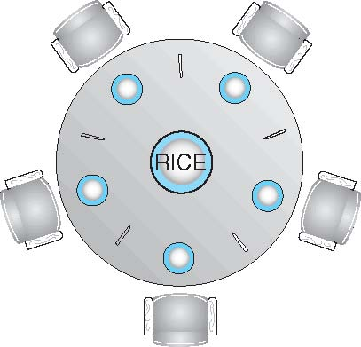
Dining-Philosophers Problem
Philosophers spend their lives alternating thinking and eating
Occasionally, they try to pick up 2 chopsticks (one at a time, one to the right and one to the left) to eat from bowl
Need both to eat, then release both when done
In the case of 5 philosophers and five chopsticks
Shared data
Bowl of rice (data set)
Semaphore chopstick [5] initialized to 1

Slide 58
Dining-Philosophers Problem Algorithm
The structure of Philosopher i:
do {
wait (chopstick[i] );
wait (chopStick[ (i + 1) % 5] );
// eat
signal (chopstick[i] );
signal (chopstick[ (i + 1) % 5] );
// think
} while (TRUE);
What is the problem with this algorithm?
If they all get hungry at the same time and grab their left chopstick, when they try to grab their right chopstick they will be delayed forever = DEADLOCK

Slide 59
Dining-Philosophers Problem Algorithm (Cont.)
Deadlock handling
Allow at most 4 philosophers to be sitting simultaneously at the table with five chopsticks available.
Allow a philosopher to pick up the chopsticks only if both are available (picking must be done in a critical section).
Use an asymmetric solution -- an odd-numbered philosopher picks up first the left chopstick and then the right chopstick. Even-numbered philosopher picks up first the right chopstick and then the left chopstick.

Slide 60
Problems with Semaphores
Incorrect use of semaphore operations:
signal (mutex) …. wait (mutex)
wait (mutex) … wait (mutex)
Omitting of wait (mutex) or signal (mutex) (or both)
Deadlock and starvation are possible.

Slide 61
Monitors
A high-level abstraction that provides a convenient and effective mechanism for process synchronization
Abstract data type, internal variables only accessible by code within the procedure
Only one process may be active within the monitor at a time
But not powerful enough to model some synchronization schemes
monitor monitor-name
{
// shared variable declarations
procedure P1 (…) { …. }
procedure Pn (…) {……}
Initialization code (…) { … }
}
}

Slide 62
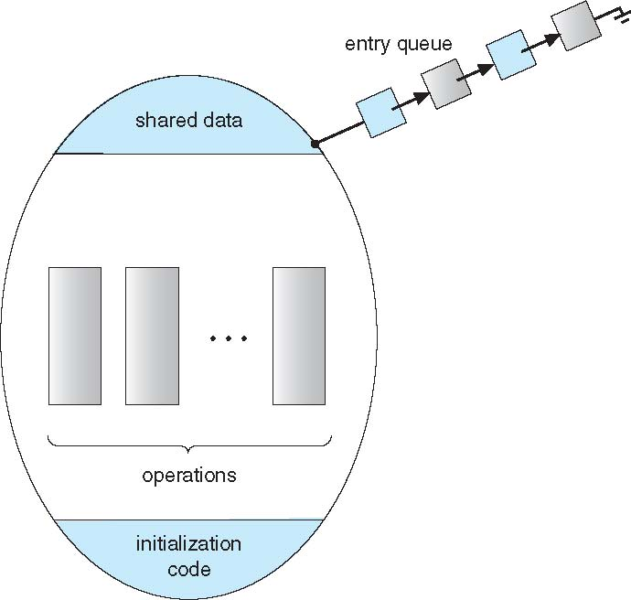
Schematic view of a Monitor

Slide 63
Condition Variables
condition x, y;
Two operations are allowed on a condition variable:
x.wait() – a process that invokes the operation is suspended until x.signal()
x.signal() – resumes one of processes (if any) that invoked x.wait()
If no x.wait() on the variable, then it has no effect on the variable

Slide 64
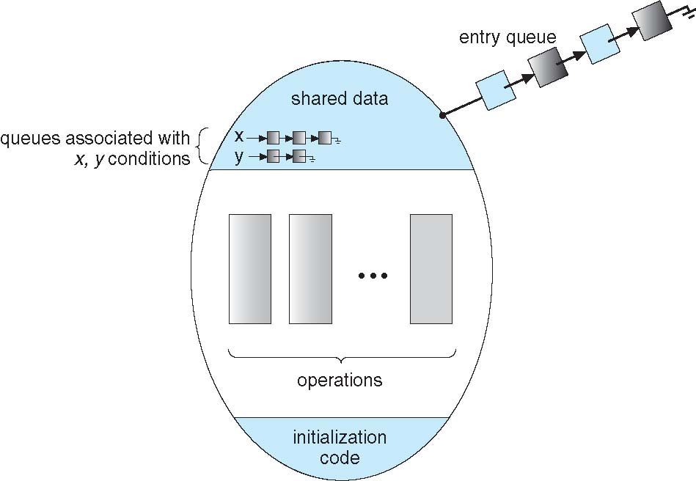
Monitor with Condition Variables

Slide 65
Condition Variables Choices
If process P invokes x.signal(), and process Q is suspended in x.wait(), what should happen next?
Both Q and P cannot execute in paralel. If Q is resumed, then P must wait
Options include
Signal and wait – P waits until Q either leaves the monitor or it waits for another condition
Signal and continue – Q waits until P either leaves the monitor or it waits for another condition
Both have pros and cons – language implementer can decide
Monitors implemented in Concurrent Pascal compromise
P executing signal immediately leaves the monitor, Q is resumed
Implemented in other languages including Mesa, C#, Java

Slide 66
Monitor Solution to Dining Philosophers
monitor DiningPhilosophers
{
enum { THINKING; HUNGRY, EATING) state [5] ;
condition self [5];
void pickup (int i) {
state[i] = HUNGRY;
test(i);
if (state[i] != EATING) self[i].wait;
}
void putdown (int i) {
state[i] = THINKING;
// test left and right neighbors
test((i + 4) % 5);
test((i + 1) % 5);
}

Slide 67
Solution to Dining Philosophers (Cont.)
void test (int i) {
if ((state[(i + 4) % 5] != EATING) &&
(state[i] == HUNGRY) &&
(state[(i + 1) % 5] != EATING) ) {
state[i] = EATING ;
self[i].signal () ;
}
}
initialization_code() {
for (int i = 0; i < 5; i++)
state[i] = THINKING;
}
}

Slide 68
Solution to Dining Philosophers (Cont.)
Each philosopher i invokes the operations pickup() and putdown() in the following sequence:
DiningPhilosophers.pickup(i);
EAT
DiningPhilosophers.putdown(i);
No deadlock, but starvation is possible

Slide 69
Monitor Implementation Using Semaphores
Variables
semaphore mutex; // (initially = 1)
semaphore next; // (initially = 0)
int next_count = 0;
Each procedure F will be replaced by
wait(mutex);
…
body of F;
…
if (next_count > 0)
signal(next)
else
signal(mutex);
Mutual exclusion within a monitor is ensured

Slide 70
Monitor Implementation – Condition Variables
For each condition variable x, we have:
semaphore x_sem; // (initially = 0)
int x_count = 0;
The operation x.wait can be implemented as:
x_count++;
if (next_count > 0)
signal(next);
else
signal(mutex);
wait(x_sem);
x_count--;

Slide 71
Monitor Implementation (Cont.)
The operation x.signal can be implemented as:
if (x_count > 0) {
next_count++;
signal(x_sem);
wait(next);
next_count--;
}

Slide 72
Resuming Processes within a Monitor
If several processes queued on condition x, and x.signal() executed, which should be resumed?
FCFS frequently not adequate
conditional-wait construct of the form x.wait(c)
Where c is priority number
Process with lowest number (highest priority) is scheduled next

Slide 73
Single Resource allocation
Allocate a single resource among competing processes using priority numbers that specify the maximum time a process plans to use the resource
R.acquire(t);
...
access the resurce;
...
R.release;
Where R is an instance of type ResourceAllocator

Slide 74
A Monitor to Allocate Single Resource
monitor ResourceAllocator
{
boolean busy;
condition x;
void acquire(int time) {
if (busy)
x.wait(time);
busy = TRUE;
}
void release() {
busy = FALSE;
x.signal();
}
initialization code() {
busy = FALSE;
}
}

Slide 75
Synchronization Example
Pthreads

Slide 76
Windows Synchronization
Uses interrupt masks to protect access to global resources on uniprocessor systems
For kernel activities Uses spinlocks on multiprocessor systems
Spinlocking-thread will never be preempted
In user mode: Also provides dispatcher objects user-land which may act like mutexes, semaphores, events, and timers
Events -acts much like a condition variable
Timers notify one or more thread when time expired
Dispatcher objects either signaled-state (object available) or non-signaled state (thread will block)
Critical-section object – a user-mode mutex that requires no kernel intervention. Starts with spinlock and only when it spins ‘too long’, it will acquire a kernel mutex and move to wait.

Slide 77
Linux Synchronization
Linux:
Prior to kernel Version 2.6, disables interrupts to implement short critical sections
Version 2.6 and later, fully preemptive
Linux provides:
Semaphores
atomic integers
Mutex
Spinlocks – fundamental locking mechanism on SMP
reader-writer versions of both
On single-cpu system, spinlocks replaced by enabling and disabling kernel preemption

Slide 78
Solaris Synchronization
Implements a variety of locks to support multitasking, multithreading (including real-time threads), and multiprocessing
Uses adaptive mutexes for efficiency when protecting data from short code segments
Starts as a standard semaphore spin-lock
If lock held, and by a thread running on another CPU, spins (short wait)
If lock held by non-run-state thread, block and sleep waiting for signal of lock being released (long wait likely)
Uses condition variables and semaphores for long code segments
Uses readers-writers locks when frequently accessed longer sections of code need read access to data
Uses turnstiles to order the list of threads waiting to acquire either an adaptive mutex or reader-writer lock
Turnstiles are per-lock-holding-thread, not per-object
Priority-inheritance per-turnstile gives the running thread the highest of the priorities of the threads in its turnstile (kernel threads only)

Slide 79
Pthreads Synchronization
Pthreads API is at the user-level
It provides:
mutex locks (fundamental synchronization mechanism)
condition variable
Read-write locks
Non-portable extensions include:
Semaphores
Named- name is in the file system and can be shared by multiple unrelated processes
Unnamed – can only be used by threads belonging to the same process.
spinlocks

Slide 80
Alternative Approaches
Transactional Memory
OpenMP
Functional Programming Languages

Slide 81
Transactional Memory
A memory transaction is a sequence of read-write operations to memory that are performed atomically.
void update()
{
atomic {
/* modify shared data */
}
}
Advantages:
System provides atomicity, not developer
No locks are involved … so no deadlock.
Transactional memory system can detect opportunities for concurrency within an atomic block
Implementation
Software Transactional Memory (STM)– code inserted by compiler to guarantee atomicity and detect concurrency options
Hardware Transactional Memory (HTM)– Uses cache hierarchies and cache coherency protocols to manage shared data conflicts. Less overhead than STM

Slide 82
OpenMP
OpenMP is a set of compiler directives and API that support parallel programming.
void update(int value)
{
#pragma omp critical
{
count += value
}
}
The code contained within the #pragma omp critical directive is treated as a critical section and performed atomically.

Slide 83
Functional Programming Languages
Functional programming languages offer a different paradigm than procedural languages in that they do not maintain state.
Variables are treated as immutable and cannot change state once they have been assigned a value.
There is increasing interest in functional languages such as Erlang (syntactically similar to Java and C#) and Scala for their approach in handling data races.

Slide 84
End of Chapter 5

